Slide 1

Public-Private Venture (PPV)
Mandatory PPV Housing Resident In-Brief
Naval Base Kitsap Housing Service Center
Notes:
Update items in the slides with local information.
HSC must use all required slides and information.
HSCs are encouraged to include additional slides for their installation.

Slide 2
Welcome
Welcome from the Navy Housing Service Center (HSC) at Naval Base Kitsap
  The Fleet and Family Readiness team provides services that enhance Quality of Life at home and work. We serve as a catalyst for maximizing partnerships for the mental,
  physical, and social development of Department of Defense personnel, retirees and family members.
The Navy HSC staff is employed by the Navy to assist and advocate for Service Members and their families on any housing issue
The Housing installation program director manages the HSC and reports directly to the installation commanding officer
  Naval Base Kitsap Installation Commanding Officer: CAPT Richard Massie, USN
  Naval Base Kitsap Installation Housing Program Director (IPD): Erik Ruud
  Naval Base Kitsap Installation Housing Program Manager: Robin Pena
Hunt Military Communities is the privatized (PPV) company that owns and manages family housing at this installation
  Hunt, as the property manager, is the primary contact for maintenance, repairs, concerns, rent/billing issues
The Navy HSC is here to assist with unresolved issues or concerns
Notes:
Suggested - Welcome

Slide 3
Overview of Topics
HSC Services and Contact Information
Hunt Contact Information
What to Expect: Move-in and Move-out
Tenant Bill of Rights
Anti Retaliation and Anti-Reprisal Rights
Understanding Your Lease
Hunt Payments and Fees
Resident Energy Conservation Program (RECP)
Tenant Responsibilities
Renters Insurance Information
Housing Health and Safety
Maintaining Your Home
How to Report Maintenance Issues
Types of Service Calls
Tracking Maintenance/Work Orders
HSC Issue Resolution Process
Dispute Resolution Process for Tenants
Connect With Navy Housing
Notes:
Suggested - Topics

Slide 4
Naval Base Kitsap
Navy Housing Service Center (HSC)
The Navy Housing Service Center is available for:
  Home finding at this installation or your next duty station
  Housing discrimination and Fair Housing complaints
  Cost savings and relief programs
  Housing questions and concerns
  Home inspections for move-in, pre-move out, move-out, or for issue resolution
  PPV Housing issue resolution
  Whenever you need a Navy Advocate for housing
HSC Contact Information:
  Street Address: Bangor Plaza, Building 2720, 2720 Ohio Street. Silverdale, WA 98315
  Phone: 360-396-4399
  Websites: kitsap.navylifepnw.com/housing
  Social Media: Facebook: Navylife Naval Base Kitsap, Instagram: @navylifepnw
  Email: Kitsap_Housing@navy.mil
Notes:
REQUIRED HSC Contact Information

Slide 5
Hunt Military Communities at
Naval Base Kitsap
Navy Privatized Housing is one of many choices Active Duty Service Members have to meet their housing needs
PPV provides benefits that are not typically offered in community rentals
  Rent cannot exceed BAH w/dependents rate
  No upfront costs including application fees
  No credit history or salary requirements
Other Amenities:
  Community Centers
  Work Out Facilities
  Playground Areas
  Parks and Walking Paths
  Dog Parks
  Basketball and Tennis Courts
  24 Hr. Maintenance line
  Behind and Outside Gate Options.
Notes:
REQUIRED Partner contact information

Slide 6
Hunt Military Communities
Contact Information
  Hunt Military Communities
  Bangor and Keyport Family Housing
  Street Address:
  4168 Greenfish Drive
  Silverdale, WA 98315
  Phone:
  360-447-5600 Bangor/Keyport
  Website: www.northwestmilitaryhousing.com
  Facebook:
  Bangor Family Housing
  Keyport Family Housing
  Email: westsoundrso@huntcompanies.com
  Hunt Military Communities
  The Landings and Bremerton Housing
  Street Address:
  2785 Cascade Pass Blvd
  Bremerton, WA 98312
  Phone:
  360-447-5900 Bremerton/The Landings
  Website:
  www.thelandingskitsap.com
  Facebook:
  The Landings
  Bremerton Family Housing
  Email:
  landingsrso@huntcompanies.com
See Hunt’s Website for Community and Neighborhood information
with Floorplans and Pictures
Notes:
REQUIRED

Slide 7
What to Expect:
Move-In and Move-Out
Move-In | Move-Out
The Resident: | The Resident
Accepts home and terms of lease | Provides a notice to vacate to Hunt
Signs a lease | Returns the home in good condition
Tours the home for quality
Hunt provides: | Hunt provides:
Lease signing | An inspection prior to move-out to assess the condition of your home
Keys | All maintenance services
Walk-through tour of your home | A move-out inspection using the same move-in inspection checklist
Move-in inspection with checklist | A final determination of any damages or repairs and associated costs
A survey asking about your move-in experience | A move-out survey for you to provide feedback
Navy HSC provides: | Navy HSC provides:
Answers to questions | Provides answers to questions and issue resolution services
Assistance with your move-in inspection | Assistance with move-out inspection, if requested
Follow-up to check-in with you | PCS assistance and HSC contact for your next location
Support to resolve any unresolved issues at move-in | Support on any issues
Notes:
REQUIRED

Slide 8
Tenant Bill of Rights
In 2020, laws were passed to assure PPV military residents’ basic rights
  A housing unit and a community that meets applicable health and environmental standards
  Working fixtures, appliances, and utilities
  A written lease with clearly defined rental terms
  A summary of the past 7 years of maintenance conducted in your prospective home
  A plain-language briefing by the installation housing office on all rights and responsibilities before signing a lease and 30 days after move-in
  Sufficient time and opportunity to prepare and be present for move-in and move-out inspections
  To report issues with habitability of the housing unit to the Landlord, the chain of command, and housing management office without fear of reprisal or retaliation
  Access to a Military Tenant Advocate or a military legal assistance attorney
  Management services that meet or exceed industry standards
Notes:
REQUIRED - Tenant Bill of Rights

Slide 9
Tenant Bill of Rights - Continued
  Consistently honest, accurate, straightforward, and responsive communications
  Access to an electronic work order system
  Prompt and professional maintenance and repair
  Advice from military legal assistance
  To enter into a standardized formal dispute resolution process
  To have rent payments segregated, with Navy approval, pending completion of the dispute resolution process
  Reasonable, advance notice of any entrance to the home
  To not pay non-refundable fees or have application of rent credits arbitrarily held
  Common documents, forms, and processes
Residents will be provided the full Tenant Bill of Rights for review
Notes:
REQUIRED - Tenant Bill of Rights

Slide 10
Anti-Retaliation and Anti-Reprisal Rights
As a tenant of PPV housing, you have the right to report issues with your housing without fear of reprisal or retaliation
You can report housing issues to the PPV company, the Housing Service Center, or your Command.
Forms of reprisal and retaliation include:
  Unlawful recovery of, or attempt to recover, possession of the housing unit
  Unlawfully increasing the rent, decreasing services, or increasing the obligations of the tenant
  Interference with a tenant’s right to privacy
  Harassment of a tenant
  Refusal to honor the terms of the lease
  Interference with the career of a tenant
If you have a concern or want to report retaliation or reprisal, you can contact in writing the Housing Service Center, your commanding officer, or the installation commanding officer
  All formal complaints will be investigated and reported to the Assistant Secretary of the Navy

Slide 11
Understanding Your Lease
All PPV companies have agreed to use the same DOD-written Universal Lease, with Navy-approved local addenda
Residents must accept and sign the PPV lease to reside in housing
The lease includes tenant’s rights and responsibilities
The resident handbook is considered part of the lease
It is important to read through and understand what you are signing
If you have questions, contact the HSC
The Universal Lease includes:
1. Military Housing Privatization Initiative (MHPI) Universal Lease with Washington State requirements for Military Members. DOD PPV Universal Lease used by all military branches
  Schedule 1 – Key Terms
  Schedule 2 – Universal Lease Fee Schedule
  Schedule 3 – Dispute Resolution Process
    Exhibit A – Request Form for Dispute Resolution Process
  Schedule 4 – Minimum Standard Tenant Displacement Guidelines
  Schedule 5 – Sample Move-In/Move-Out Checklists
Notes:
UNDERSTANDING LEASE

Slide 12
Understanding Your Lease - Continued
2. In addition to the lease itself, the Hunt lease includes several required addenda:
    Community Specific Addendum
    Mold Information and Prevention Addendum
    Asbestos Containing Materials Addendum
    Lead-Based Paint Addendum
      Section 1018 Disclosure of Lead-Based Paint Components and Lead-Based Hazards
    Basement Damage Addendum
    Flood Notice Addendum
    Resident Energy Conservation Program (RECP) Addendum
    Pet Addendum
      Please note Dog Breed Restrictions to include any dog with a mix of any below breeds:
        Pit Bill (American Staffordshire Bull Terrier or English Staffordshire Bull Terrier), Rottweiler, Presa Canarios, Doberman Pinscher, Chow Chow, Akitas, Mastiffs, Great Danes, Alaskan Malamutes, and wolf hybrids.
Notes:
UNDERSTANDING LEASE

Slide 13
Understanding Your Lease - Continued
    Construction and Relocation Addendum
      Construction Relocation Moving Rules and Guidelines
    Amenity Waiver and Release
    Statutory Notices and Discloser of Bed Bug Information Addendum to Lease Agreement
    Community Center and Fitness Room Contractual Agreement
    Historic Home Addendum (if applicable)
    Key Addendum
    Notice of Sex Offender Policy Addendum
    Permission to Enter Addendum
    Release Form for Photographic Images and/or Audio Recordings
    Satellite Dish and Antenna Addendum
    Self Maintained Flower Agreement
    Addendum to Rental Agreement for Smoke Detectors and Carbon Monoxide Detectors
    Washer and Dryer Addendum
    Weapons Addendum
    Window Safety Addendum
      Window Safety Tips
Notes:
UNDERSTANDING LEASE

Slide 14
Understanding Your Lease - Continued
3. You may also be asked to sign additional addenda as needed:
    Munitions Precautions Briefing Addendum – The Landings Only
    Accessible Housing Addendum
    Fireplace Lease Addendum (operational)
    General Officer Home and Flag Officer home Addendum
    Home Based Business Addendum
    Homes with Fenced Backyards
    Key and Essential (K&E) Addendum
    Live-In Care Provider
    Long Term Guest
    Move-In Special Concession Addendum
    Market Rent Addendum
    Roommate Addendum
    Service Animal or Assistance Animal Request Addendum
It is important to read through and understand what you are signing. If you have questions, contact the HSC or Hunt
    Navy HSC at 360-396-4399 or
    Hunt Military Communities: Bangor, Keyport, 360-447-5600 or The Landings, Bremerton, 360-447-5900
Notes:
UNDERSTANDING LEASE

Slide 15
Hunt Payment and Fees
  Per Navy policy, military service members pay military housing rent in arrears by allotment
    Hunt will initiate the allotment collecting rent monthly in arrears. For example: August rent is collected through allotment during the month of August and sent to Hunt on September 1st paying your August rent payment.
    US Coast Guard and Marine Corps service members are required to initiate and update their own allotments. This includes updating allotments when BAH changes occur (examples: promotions or yearly changes). Not doing so could result in additional back payment of full rent and/or rental late fees.
    Move In and Move Out partial rent payments (pro-rates) may require direct payment coordinated by Hunt.
  Standard Fees authorized by the lease and optional services
    $50 Late Fee - For Rent not paid by the 5th of the month
    $25 Returned Check Fee - For insufficient funds
    One Month’s Full Rent Early Termination Charge – For breaking, or terminating, the lease prior to the lease term period end date
    $68 Key Fob Replacement Fee – For replacement of lost or damaged key fob
    $43 Garage Remote Replacement Fee – For replacement of lost or damaged garage remote
  Additional Fees
    Extra Trash Charge, Damage Fees, Pet Sanitation Fees, Pet Waste Pick-Up Fees
Notes:
REQUIRED Fees and Payments

Slide 16
Resident Energy
Conservation Program (RECP)
The NDAA temporarily suspended the RECP Program in 2020
  Residents will continue to receive statements, but no payments are required
  Residents will be notified prior to RECP resuming
  PPV partners are ensuring that all homes have accurate meters
Basic Allowance for Housing (BAH)/Rent includes an amount for utilities
“Normal” utilities usage is determined by house type
Residents that use more will receive a bill for the amount over “normal”
Residents that use less will receive a credit for the amount conserved
Residents with serious medical conditions can be exempted with NSE Commanding Officer approval
  Contact the Navy HSC office for the waiver request application
  Wounded Warriors are exempt upon request
Visit www.cnic.navy.mil/RECP for detailed information about RECP
Notes:
SUGGESTED
Provide residents with RECP flier.
Note: RECP is currently suspended. NDAA bullet will need to be removed once the suspension is lifted.

Slide 17
Tenant Responsibilities
Per your lease, it is your responsibility to:
  Report in a timely manner any apparent environmental, safety, or health hazards of the housing unit to the landlord and any defective, broken, damaged, or malfunctioning building systems, fixtures, appliances, or other parts of the housing unit, the common areas, or related facilities
  Maintain standard upkeep of the housing unit as instructed by the housing management office
  Conduct oneself as a tenant in a manner that will not disturb neighbors, and to assume responsibility for one’s actions and those of a family member or guest in the housing unit or common areas
  Not engage in any inappropriate, unauthorized, or criminal activity in the housing unit or common areas
  Allow the landlord reasonable access to the rental home in accordance with the terms of the tenant lease agreement to allow the landlord to make necessary repairs in a timely manner
  Read all lease-related materials provided by the landlord and to comply with the terms of the lease agreement, lease addenda, and any associated rules and guidelines
Notes:
REQUIRED – Tenant Responsibilities
Note: Per the NDAA, resident responsibilities will be defined and incorporated in the universal lease. Update when incorporated into the lease.

Slide 18
Tenant Responsibilities - Continued
Animal Responsibilities
  You are responsible for your animals at all times
  Residents are responsible for all animal damage to their home or common spaces
  Hunt “Pet Bite, Pet Gone” Policy – All reported pet bites require removal of pet from the home
Important local policies to consider. If you have further questions, please contact the HSC or Hunt.
  Personal protection/safety and security/firearms
  Facility use and services
  Visitors and guests
  Parking
Additional Tenant Responsibilities
  Renters insurance is a responsibility of the resident, and is strongly encouraged to protect your belongings and prevent financial hardships
  Residents are responsible for keeping their home clean and in good order
Notes:
REQUIRED – Tenant Responsibilities
Suggested - Important local policies to consider.

Slide 19
Renters Insurance Information
Your lease includes the requirement for you to maintain a General Liability renters insurance policy to cover no less than $100,000. Renters insurance is NOT part of the rent you pay to Hunt.
All Service Members are encouraged to purchase additional personal renters insurance, in addition to the Hunt required General Liability insurance, for protection from unexpected expenses. Basic policies generally cover personal property – most renters’ property is worth more than the most basic coverage.
Basic coverage may not cover the rental unit itself – meaning if damage is caused and the tenant is at fault (like a kitchen fire or washing machine flood) YOU may be charged the full amount to repair the unit. Ask these questions of your insurance provider.
Renters insurance is widely available – and may even be available through your car insurance company
Make sure you understand what is and is not covered in your insurance policy.

Slide 20
Renters Insurance Information - Continued
What, and how much, is covered varies by insurance carrier.
  It’s important to ask questions to better understand your insurance coverage options and policy. Shop around, coverage and costs vary by carrier.
Personal Property and Liability Coverage:
  Make sure you understand how much insurance coverage you're purchasing and exactly what it covers.
  Ask your agent about limits, deductibles, and discounts.
  Is it enough to cover most of your personal property big ticket items if they are damaged or stolen?
Liability Coverage – Sample Situations and Questions to Ask:
  If hot BBQ coals were put in a trash can next to the garage and caused a fire to the home, will my coverage pay for damages? Now owe landlord $15,000.
  If my washing machine water supply line hose leaks causing major water and moisture damage, will my coverage pay for damages? Now owe landlord $10,000.
Your Housing Service Center or Legal Service Office can also help you understand your policy and where to supplement it if needed.

Slide 21
Renters Insurance Information - Continued
Basic Personal Property Renters Insurance normally covers:
  Your belongings if they are stolen or are damaged because of things like fire, theft, or water damage.
  Speak to your insurance agent/broker about how much coverage you should have.
    Take an inventory (photos/video) of your belongings itemizing with a price estimate. Personal belongings like clothing, furniture, TVs, computers, gaming systems, etc. all add up quickly!
Loss of Use Renters Insurance coverage (included in most policies):
  May cover costs like food and lodging if your home is damaged and you need to stay somewhere else while it's repaired.
Liability and Medical Payment Renters Insurance coverage protects you if:
  A visitor slips and/or falls and is injured at your rental home.
  You, or your visitor, accidentally start a fire causing damage to your rental home and leaving you responsible for damages and repairs.

Slide 22
Health and Safety
Navy Housing Service Centers (HSCs) provide support with issue resolution for customers living in military, privatized and community housing.
We stand ready to serve as your:
  Navy advocate for you and your family when housing maintenance, health or safety issues arise
  Independent facilitator to help you and your landlord communicate when there is an issue and facilitate a mutually-agreed upon resolution
  Liaison to military leadership and legal offices to address issues that cannot be resolved using our services
Contact your HSC if you have a housing complaint or need resolution on a housing issue.
  Phone: 360-396-4399
  Email: Kitsap_Housing@navy.mil
Notes:
Health and Safety Cover Page

Slide 23
Health and Safety – Window Safety
Warm weather and the urge to open a window pose a potential danger that many people don't realize until it's too late – window falls.
Window safety stickers and latches should be installed on 2nd floor windows. Contact Hunt if missing or broken.
Teach children about the hazards of playing near an open window and make sure they understand that a screen will not stop them from falling. Additional safety tips and resources can be found in the linked below.
Resource:
  National Safety Council Window Safety Information:
  https://www.nsc.org/home-safety/safety-topics/child-safety/window-safety
Notes:
Health and Safety Window Safety Information

Slide 24

Health and Safety – Window Safety
Notes:
Health and Safety - Window Safety Tips

Slide 25
Health and Safety – Lead Paint
Many houses and apartments built before 1978 have paint that contains lead (called lead-based paint). Lead from paint, chips, and dust can pose serious health hazards if not taken care of properly.
Federal law requires that individuals receive certain information before renting or buying a pre-1978 housing:
  LANDLORDS must disclose known information on lead-based paint and lead-based paint hazards before leases take effect. Leases must include a disclosure form about lead-based paint.
Resources: EPA Lead Information: https://www.epa.gov/lead
  Information Pamphlets found on this site:
  Protect Your Family from Lead in Your Home
  Renovate Right: Important Lead Hazard Information for Families, Child Care Providers, and Schools
Notes:
Health and Safety – Lead Paint Information

Slide 26

Health and Safety - Mold
Kitsap_Housing@navy.mil
Everett_Housing@navy.mil
Whidbey_Housing@navy.mil
Notes:
Health and Safety – Mold Information Brochure

Slide 27
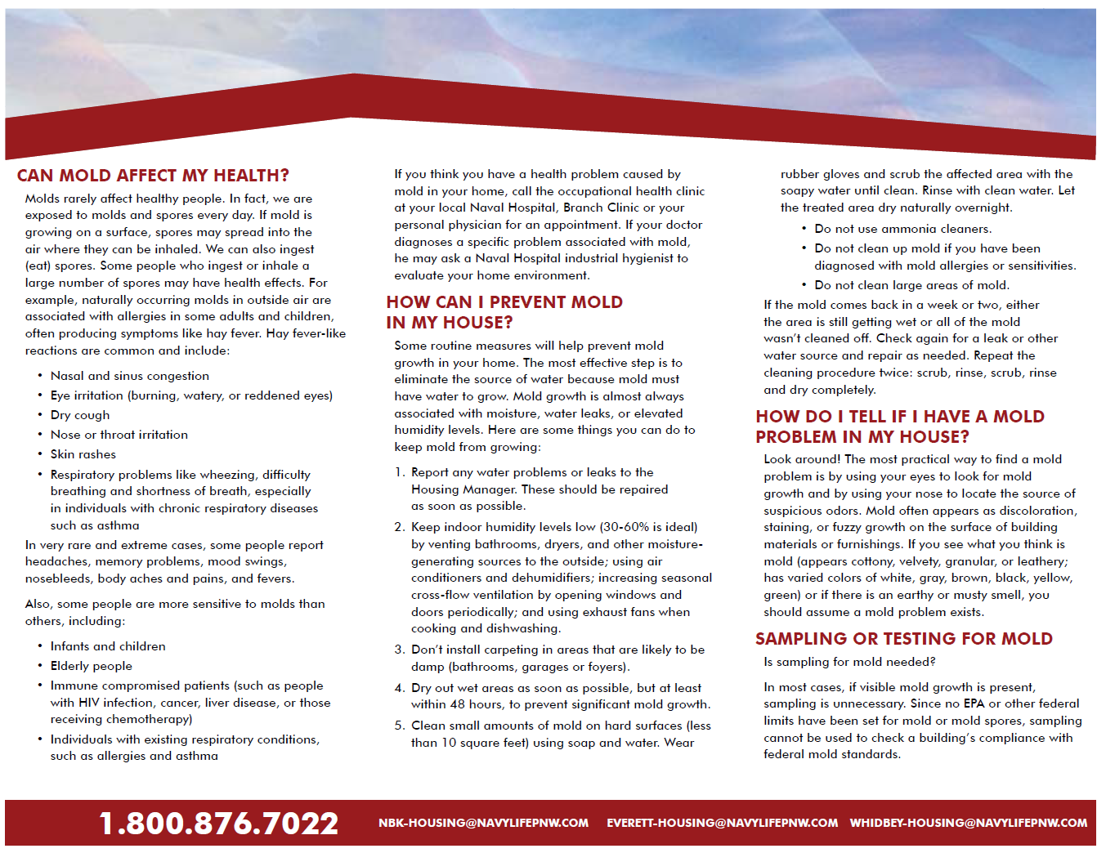
Health and Safety - Mold
Notes:
Health and Safety – Mold Information Brochure

Slide 28
Maintaining Your Home
Summer Weather
  Majority of Northwest PPV homes are built without central air conditioning as summer weather has not historically reached high sustaining heat levels. When high temps do occur periodically, being prepared in advance will aid in keeping comfortable.
  Hunt allows free-standing portable air conditioning units. Window mounted box units can be requested and installed by Hunt once approved as a special request.
  Purchase fans and air conditioners prior to the summer months. Once heat levels rise, local stores quickly run out of inventory.
Prevent Pests
  Promptly clean kitchen counters and dispose of food debris
  Keep food in air-tight containers
  Clear outside doorways and windows of leaves and dirt
  Remove uncovered or loose trash from patios or outside areas
  Keep pet food inside
Prevent Mildew, Moisture, Mold
  Check your toilets and faucets for leaks
  Use exhaust fans in bathrooms and laundry rooms
  Report leaks and issues immediately
  Check drains and keep them clear
Prevent Damage to Appliances and Systems
  Check and change your filters
  Clean and monitor major appliances
  Check and change batteries for smoke/CO detectors
Report Maintenance Issues to Hunt Immediately!
  Maintenance emergencies, Trouble calls, Safety concerns, Resident compliance issues
Notes:
REQUIRED

Slide 29
How to Report Maintenance Issues
Contact Hunt to Report Maintenance Issues Right Away
  EMERGENCY Maintenance Work Orders:
    Call by Phone:
          Bangor/Keyport – 360-447-5600, Option #2
          The Landings/Bremerton – 360-447-5900, Option #2
  URGENT Maintenance Work Orders:
    Call by Phone:
          Bangor/Keyport – 360-447-5600, Option #2
          The Landings/Bremerton – 360-447-5900, Option #2
  ROUTINE Maintenance Work Orders:
    Call by Phone:
      Bangor/Keyport - 360-447-5600, Option #2
      The Landings/Bremerton – 360-447-5900, Option #2
    2. Complete Online Work Order at:
      Bangor, Bremerton, Keyport Family Housing: https://northwestmilitaryhousing.securecafe.com/residentservices/navy-nw-west-bangor-bremerton-and-keyport/userlogin.aspx
      The Landings: https://thelandingskitsap.securecafe.com/residentservices/navy-nw-jackson-park/userlogin.aspx
    3. Download HUNT Resident App from Apple, Android or Microsoft. Contact Hunt for details.
Notes:
REQUIRED
Include any specific requirements for reporting maintenance issues, such as emergency maintenance must be reported by phone, not the app or email, etc.

Slide 30
Types of Service Calls
Type of Service Call | Examples | How can a Resident Submit a Service Work Order? | Hunt Response Time Depending on Parts
Emergency Critical safety, life threatening issues Resident with a medical requirement for stable temp levels | Gas leaks, fire, power loss, sewage back-up, flood, only toilet inoperable | Call Hunt Maintenance Number: Bangor/Keyport: 360-447-5600, Option #2 The Landings/Bremerton: 360-447-5900, Option #2 | 30-minute initial response during normal business hours, 60 minutes after-hours and weekends Available 24/7/365
Urgent Habitability Issue | Broken window, garage door inoperable, kitchen sink back-up, refrigerator inoperable | Call Hunt Maintenance Number Bangor/Keyport: 360-447-5600, Option #2 The Landings/Bremerton: 360-447-5900, Option #2 | 4-hour initial response Available 24/7/365
Routine Convenience Unit care issues | Single burner inoperable, repair screens, fence slat broken | Call Hunt Maintenance Number: Bangor/Keyport: 360-447-5600, Option #2 The Landings/Bremerton: 360-447-5900, Option #2 Complete Online Resident Work Order, or use Hunt’s Resident App | 24 hours, 1 working day initial response Every effort to resolve the service request within 5 working days after appointment
Notes:
REQUIRED
Types of Service Calls – Update COVID19 as Needed

Slide 31
Tracking Maintenance/Work Orders
Routine Work Orders can easily be submitted and tracked:
    Online Resident Portal Work Order: Complete Online Work Order
    Bangor, Bremerton, Keyport Family Housing: https://northwestmilitaryhousing.securecafe.com/residentservices/navy-nw-west-bangor-bremerton-and-keyport/userlogin.aspx
    The Landings: https://thelandingskitsap.securecafe.com/residentservices/navy-nw-jackson-park/userlogin.aspx
    Download HUNT RESIDENT APP from Apple, Android or Microsoft.
      Contact Hunt for registration information.
Notes:
REQUIRED

Slide 32
HSC Issue Resolution Process
Report issues to your Hunt Property Manager
If your issue is not resolved to your satisfaction, contact the Navy HSC
Counselors are available to help you communicate with the Hunt Property Manager to assist in finding a mutually agreed upon resolution
You can always contact your chain of command with your housing issues
The Navy HSC is the military tenant advocate for you and your family when any housing issues arise
Additional Resources Include:
Fleet & Family Services (FFS), Region Legal Service Office (RLSO) and, in cases of health concerns, your Primary Care Physician
Notes:
REQUIRED
Navy Advocate – TBOR right to a Housing Advocate and Legal Representation – what HSC will do as part of issue resolution.
Add information about what HSC does as part of issue resolution. Remind them that the Housing Advocate is your (call back to BOR) is your housing counselor.
RLSO slide – input into here – and issue resolution slide. (ASK MCICOM for this)

Slide 33
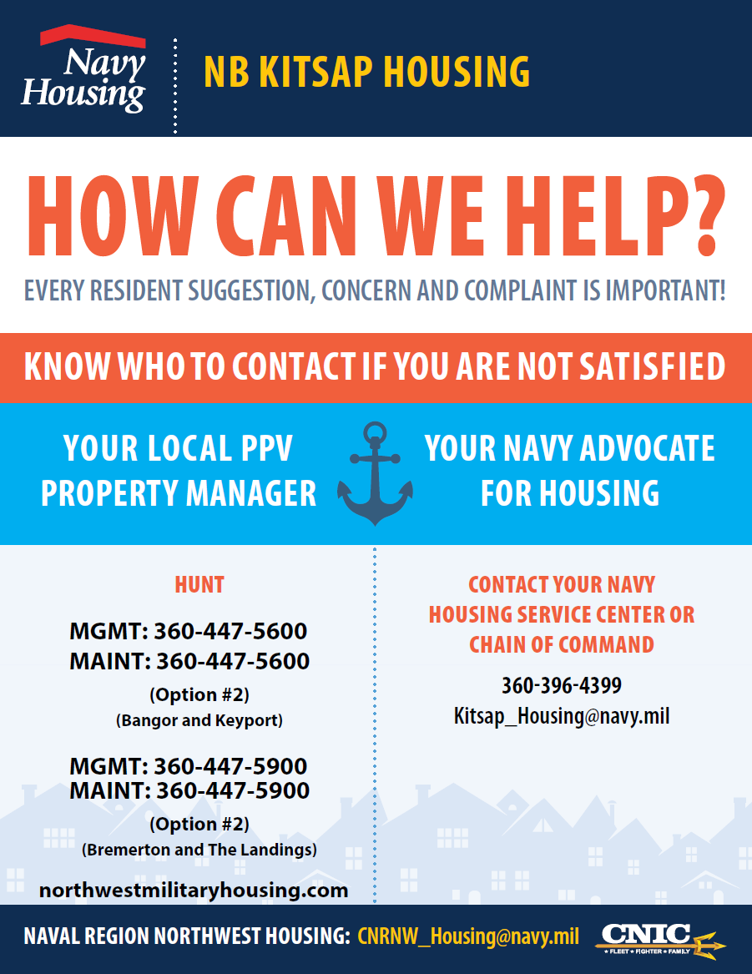
HSC Issue Resolution Process
UNCLASSIFIED
Notes:
REQUIRED

Slide 34
Dispute Resolution Process for Tenants
As a tenant of PPV Military housing, you have the right to exercise the Formal Dispute Resolution Process and the right to have your rental payments held from Hunt pending a formal dispute process.
Basics of the Formal Dispute Resolution Process include:
  You must first attempt issue resolution working directly with Hunt. If unsuccessful, the Navy HSC is your next step in supporting and attempting issue resolution.
  If no resolution is reached, you may initiate the Formal Dispute Resolution Process by submitting a Dispute Resolution Form to the Navy HSC.
  An independent Dispute Resolution Investigator will investigate the formal dispute. To use the Dispute Resolution Process, you must allow Hunt, Navy HSC, and the Dispute Resolution Investigator into your home for inspection(s). The HSC will attempt to schedule at a convenient time for all parties.
  The tenant, Hunt, Navy HSC, and the Dispute Resolution Investigator will provide written recommendations for resolution of the dispute.
  The deciding authority, generally the Regional Commander, will make the final decision.
The process is expected to take 30-60 days.
You can find the Dispute Resolution Form, as well as the full policy, online at kitsap.navylifepnw.com/housing or email Kitsap_Housing@navy.mil
Notes:
REQUIRED

Slide 35

HSC Issue Resolution Process
UNCLASSIFIED
Navy Region Legal Services NW
RLSO NW Bremerton
  365 S. Barclay Bldg 433, Code 1308
  Bremerton, WA 98314-5260
  (360) 476-4275
  DSN: 627-4275
RLSO NW Bangor
  1001 Tautog Circle, Bldg. 1001
  Naval Base Kitsap Bangor
  Silverdale, WA 98315
  (360) 396-6003
Website:
https://www.jag.navy.mil/legal_services/rlso/rlso_northwest.htm
Notes:
REQUIRED

Slide 36




Connect with Navy Housing
Find your local Navy Housing Service Center (HSC)
  Bangor Plaza, Building 2720
  2720 Ohio Street. Silverdale, WA 98315
  360-396-4399
www.facebook.com/Navylife Naval Base Kitsap
@navylifepnw
www.pinterest.com/NavyHousing
www.YouTube.com/NavyHousing
  Visit: kitsap.navylifepnw.com/housing Email: Kitsap_Housing@navy.mil
Notes:
REQUIRED

